Slide 1
Design and Analysis and of Algorithms

Slide 2
Agenda – session 15
Definition of P and NP classes and examples
Understanding NP-Completeness: CNF-SAT Cook-Levin theorem
Polynomial time reducibility: CNF-SAT and 3-SAT, Vertex Cover
Polynomial time reducibility: Clique and Set-Cover, Subset-Sum and Knapsack

Slide 3
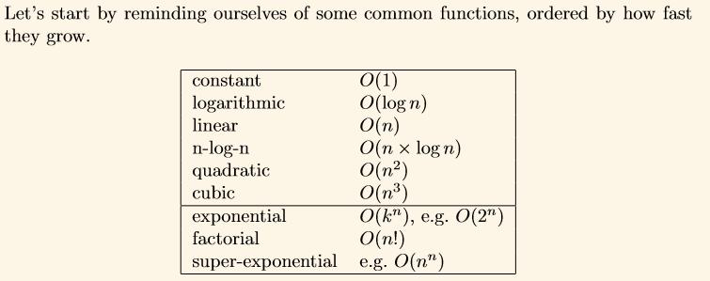

Slide 4



Slide 5
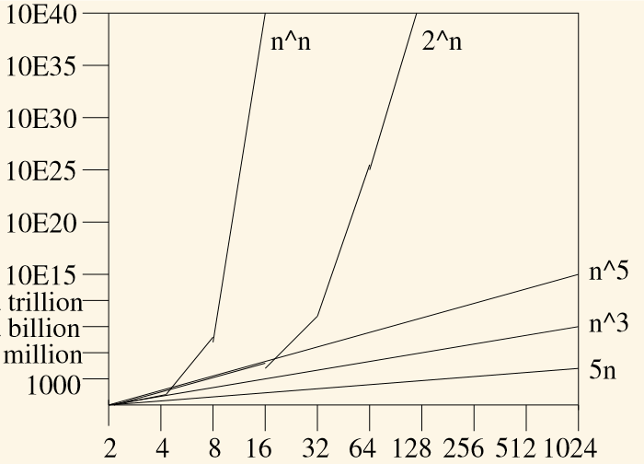

Slide 6
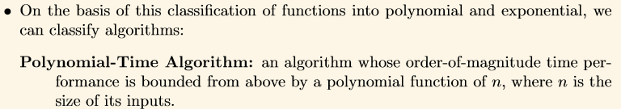

Slide 7
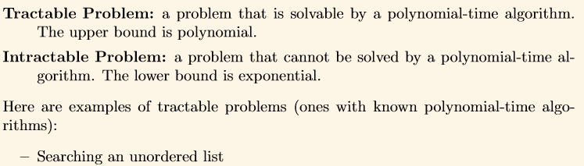

Notes:
Tractable : controllable, manageable, malleable, governable, yielding, amenable, complaisant, compliant; adjustable;
docile, submissive, obedient, tame, meek, easily handled.
Intractable: unmanageable, uncontrollable, ungovernable, out of control, out of hand, impossible to cope with; difficult, awkward, complex, troublesome, demanding, burdensome
"their problems have become more severe and intractable"

Slide 8
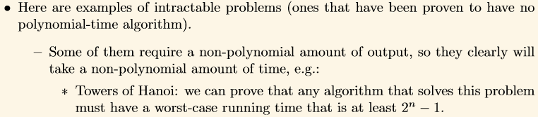

Slide 9

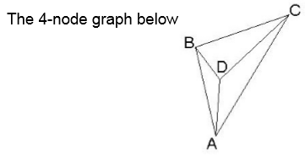

Slide 10
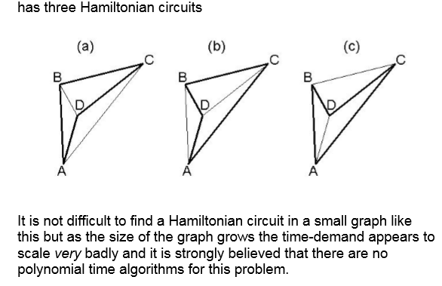

Slide 11
P
Say you have an algorithm that finds the smallest integer in an array. One way to do this is by iterating over all the integers of the array and keeping track of the smallest number you've seen up to that point. Every time you look at an element, you compare it to the current minimum, and if it's smaller, you update the minimum. How long does this take? Let's say there are n elements in the array. For every element the algorithm has to perform a constant number of operations. Therefore we can say that the algorithm runs in O(n) time, or that the runtime is a linear function of how many elements are in the array. So this algorithm runs in linear time. You can also have algorithms that run in quadratic time (O(n^2)), exponential time (O(2^n)), or even logarithmic time (O(log n)). Binary search (on a balanced tree) runs in logarithmic time because the height of the binary search tree is a logarithmic function of the number of elements in the tree. If the running time is some polynomial function of the size of the input, for instance if the algorithm runs in linear time or quadratic time or cubic time, then we say the algorithm runs in polynomial time and the problem it solves is in class P.

Slide 12
NP – (NP is not “Non-Polynomial” ,
But actually it is Non-deterministic Polynomial time )
Now there are a lot of programs that don't (necessarily) run in polynomial time on a regular computer, but do run in polynomial time on a nondeterministic Turing machine. These programs solve problems in NP, which stands for nondeterministic polynomial time. A nondeterministic Turing machine can do everything a regular computer can and more. This means all problems in P are also in NP. An equivalent way to define NP is by pointing to the problems that can be verified in polynomial time. This means there is not necessarily a polynomial-time way to find a solution, but once you have a solution it only takes polynomial time to verify that it is correct. Example – Suduku.
Notes:
A Turing machine is a hypothetical machine thought of by the mathematician Alan Turing in 1936. Despite its simplicity, the machine can simulate ANY computer algorithm, no matter how complicated it is!

Slide 13
The kinds of problems we deal with in complexity theory come in pairs: a "search" version and a "verification" version. For example --
Problem: sorting. Search version: input a list of numbers X and output the same list in sorted order (call it Y). Verification version: input a list of numbers X and another list Y, and output "YES" if Y is the sorted version of X and "NO" otherwise.
Problem: graph coloring. Search version: input a network of nodes and edges X, and output colors Y for each node such that no adjacent nodes have the same color. Verification version: input a network X and a set of colors Y and output "YES" if all adjacent nodes have different colors and "NO" otherwise.
Problem: partition. Search version: input some numbers X and divide the numbers into two groups that add up to exactly the same value (call the assignment of numbers to their group Y). Verification version: input some numbers X and the groupings Y and output "YES" if the two groups add up to the same value, or "NO" otherwise.

Slide 14
NP-Complete
is a complexity class which represents the set of all problems X in NP for which it is possible to reduce any other NP problem Y to X in polynomial time.
Intuitively this means that we can solve Y quickly if we know how to solve X quickly. Precisely, Y is reducible to X, if there is a polynomial time algorithm f to transform instances y of Y to instances x = f(y) of X in polynomial time.

Slide 15
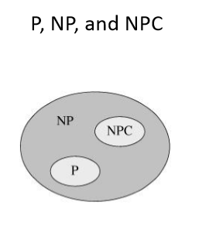

Slide 16
NP-hard:
Intuitively, these are the problems that are at least as hard as the NP-complete problems. Note that NP-hard problems do not have to be in NP, and they do not have to be decision problems.
The precise definition here is that a problem X is NP-hard, if there is an NP-complete problem Y, such that Y is reducible to X in polynomial time.
But since any NP-complete problem can be reduced to any other NP-complete problem in polynomial time, all NP-complete problems can be reduced to any NP-hard problem in polynomial time. Then, if there is a solution to one NP-hard problem in polynomial time, there is a solution to all NP problems in polynomial time.
Example
The halting problem is an NP-hard problem. This is the problem that given a program P and input I, will it halt? This is a decision problem but it is not in NP. It is clear that any NP-complete problem can be reduced to this one. As another example, any NP-complete problem is NP-hard.

Slide 17
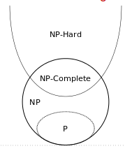

Slide 18
Yesterday many problems were in NP today they are in P.
Example – Merge Sort.
Today what ever is NP tomorrow they may get into P .

Slide 19
We are always interested in reducing the polynomial time complexity of any problem to O(1) and this is a continuous research interest we want everything to happen in O(1) !!!!
At the same time we want exponential time problems to be reduced to polynomial time.
Because 2^{n} is very costly compared to n¹⁰, n¹⁰⁰ for some large values of n.
Show the similarity / association / relation between different exponential problems and if one problem is solved in polynomial time we can prove the other problem also in polynomial time.
If polynomial time deterministic algorithms are not been able to be written for these problems then write non-deterministic algorithm.

Slide 20
Problem Statement : Search an element x on A[1:n] where n>=1, on successful search return j if a[j] is equals to x otherwise return 0.
Non-deterministic Algorithm for this problem :
1. j= choice(a, n) ---------→ Non-deterministic statement O(1) -> assumption
2. if(A[j]==x) then
{
write(j);
success();
}
3. write(0);
failure();

Slide 21
Deterministic Algorithm | Non-deterministic Algorithm
For a particular input the computer will give always same output. | For a particular input the computer may give different output on different execution.
Can solve the problem in polynomial time. | Can’t solve the problem in polynomial time.
Can determine the next step of execution. | Cannot determine the next step of execution due to more than one path the algorithm can take.

Slide 22
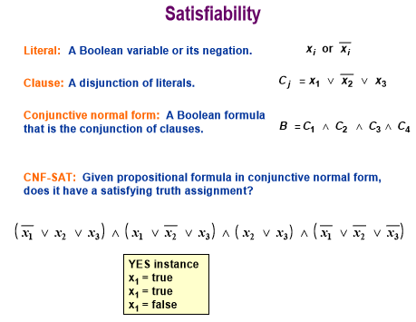

Slide 23
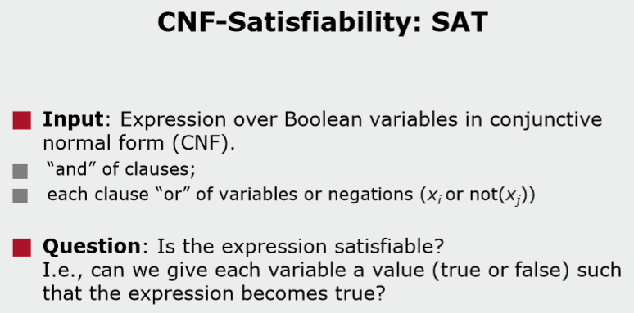

Slide 24
CNF - SAT
There are a number of practical problems for which no solution is known other than variations of Backtracking. One such problem is CNF satisfiability. Recall that a formula involving boolean variables x₁, x₂, ..., x_{n} and their negations is in Conjuctive Normal Form (CNF) if it is a conjunction of disjunctions. For example, the formula
(x₁ .or. x₃) .and. (-x₁ .or. x₂ .or. x₃) .and. (-x₁ .or. -x₂) .and. (x₂ .or. -x₃) is in CNF.
The fundamental question about CNF formulas is their satisfiability, i.e., is there a truth assignment to the boolean variables in the formula which makes the formula evaluate to TRUE?
Takes 2^{n}

Slide 25
I would start from the question, what's SAT in general. SAT is satisfiability problem - say you have Boolean expression written using only AND, OR, NOT, variables, and parentheses. The SAT problem is: given the expression, is there some assignment of TRUE and FALSE values to the variables that will make the entire expression true?
For example,
x1∧x2∨x3
SAT problem for this Boolean expression: is there such values of x1,x2,x3 , that given Boolean expression is TRUE. The answer to SAT problem is only YES or NO. We don't care what's the values of x1,x2,x3 , just existence of such values.
If this is OK, let's go further.
SAT3 problem is a special case of SAT problem, where Boolean expression should have very strict form. It should be divided to clauses,such that every clause contains of three literals.
For example,
(x1∨x2∨x3)∧(x4∨x5∨x6)
This Boolean expression in 3SAT form, 2 clauses, each clause contains of 3 literals. The question is the same, is there such values of x1....x6 , that given Boolean expression is TRUE

Slide 26
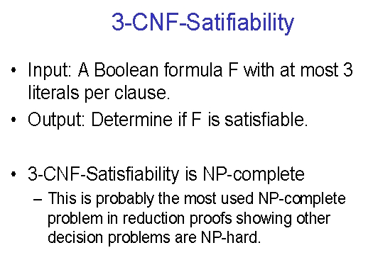

Slide 27
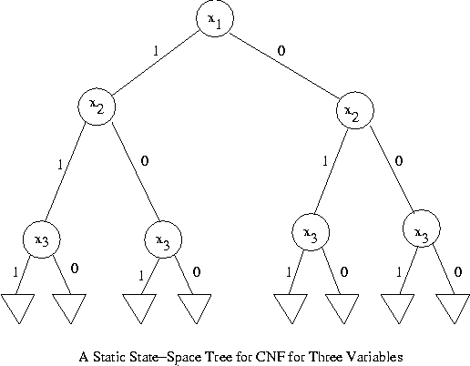

Slide 28
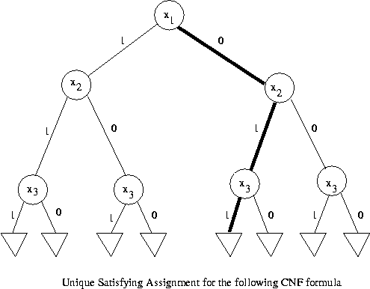

Slide 29
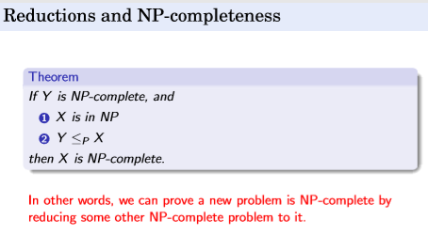
Reduction
If CNF SAT can be solved in polynomial time then other similar problems in NP can be solved polynomial time – Conversion from one type problem to other is called Reduction .

Slide 30
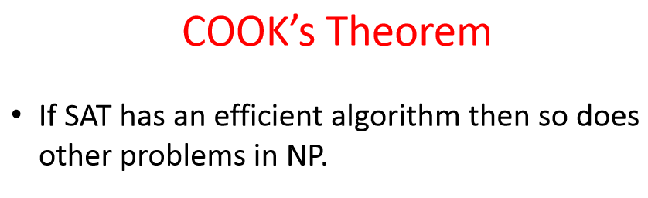

Slide 31
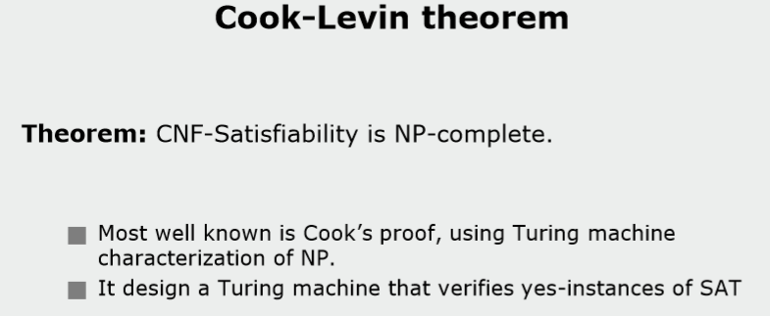

Slide 32
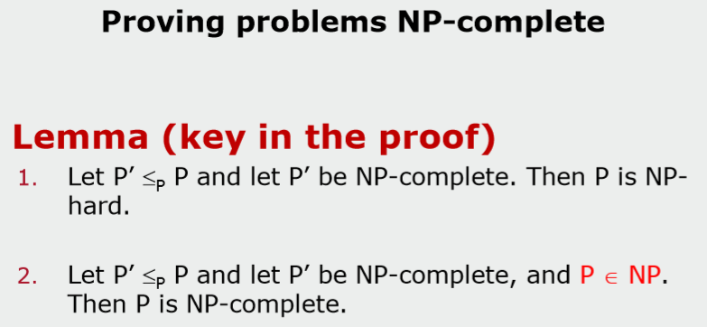

Slide 33
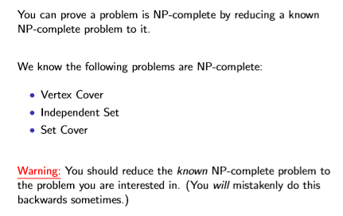

Slide 34
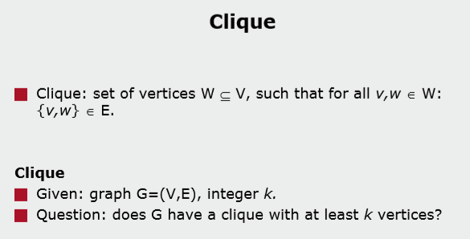

Slide 35
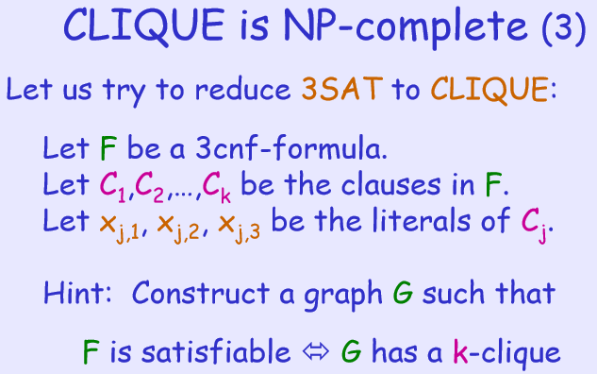

Slide 36
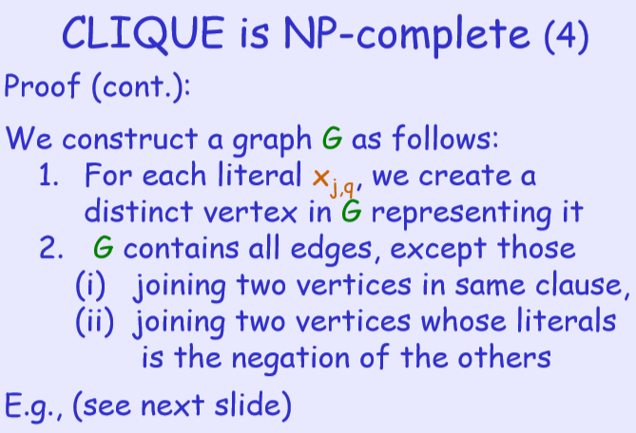

Slide 37
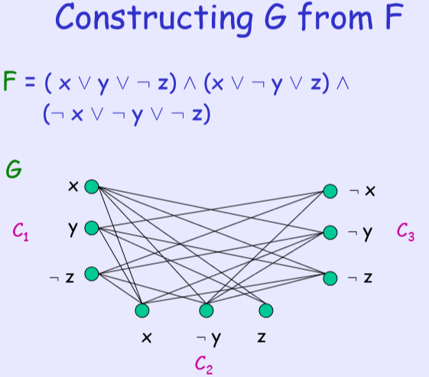

Slide 38
Other Similar problems – self Study

Slide 39
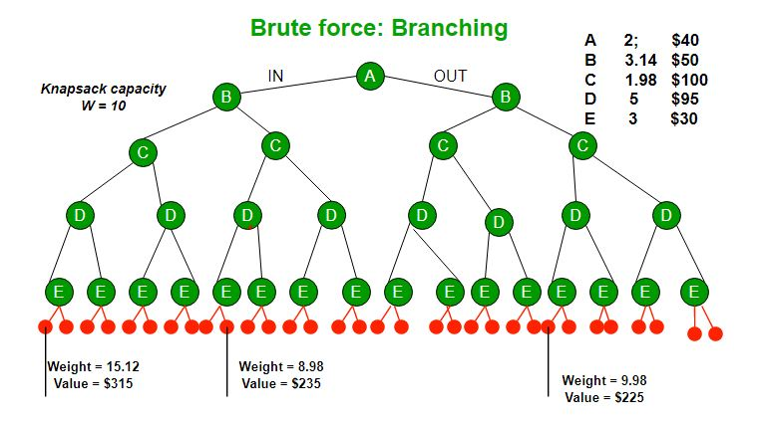

Slide 40
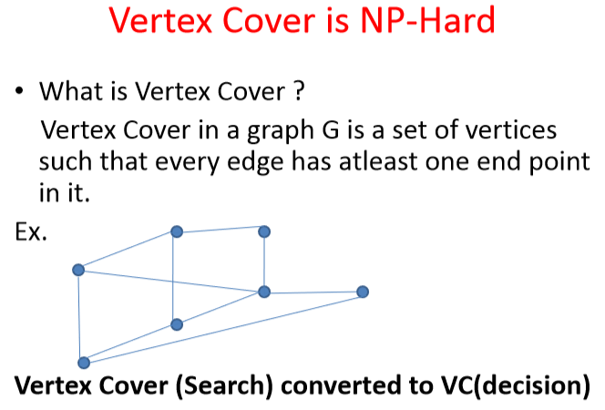

Slide 41
SET COVER
Given: A set O and a collection C of subsets of O. Find: A subcollection D of C such that every element of O is in exactly one set in D. (In other words, the union of the sets in D is O and the intersection of any two sets in D is empty.)
Example: O = { a,b,c,d,e,f,g,h,i,j,k,l }
C = { C1, C2, C3, C4, C5, C6, C7, C8 } where
C1 = {a, b, c}
C2 = {a, d}
C3 = {b, c, d, e}
C4 = {b, c, h, k}
C5 = {c, f, g}
C6 = {e, g, i}
C7 = {f, j, l}
C8 = {f, k}
Solution: D={C2, C4, C6, C7}

Slide 42
Subset Sum
Subset sum problem is to find subset of elements that are selected from a given set whose sum adds up to a given number K. We are considering the set contains non-negative values. It is assumed that the input set is unique (no duplicates are presented).

Slide 43
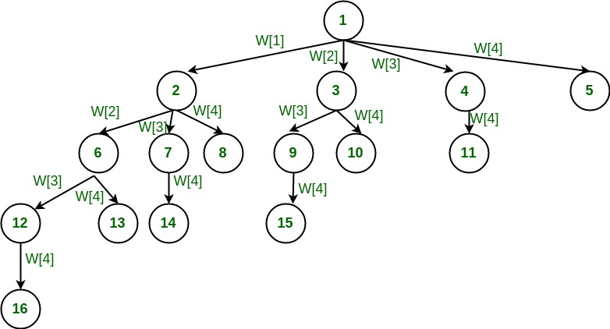

Slide 44
Concepts of Approximation algorithm
Many problems of practical significance are NP-complete but are too important to abandon merely because obtaining an optimal solution is intractable.
If a problem is NP-complete, we are unlikely to find a polynomial-time algorithm for solving it exactly, but even so, there may be a hope.
There are at least three approaches to getting around NP-completeness.
First, if the actual inputs are small, an algorithm with exponential running time may be perfectly satisfactory.
Second, we may be able to isolate important special cases that are solvable in polynomial time.
Third, it may still be possible to find near-optimal solutions in polynomial time (either in the worst case or on average).
In practice, near-optimality is often good enough. An algorithm that returns near-optimal solutions is called an approximation algorithm.

Slide 45
Approximation algorithm of vertex cover problem
C ← Ø
E′ ← E [G]
while E′ ≠ Ø
do let (u, v) be an arbitrary edge of E′
C ← C U {u, v}
remove every edge in E′ incident on u or v
return C

Slide 46
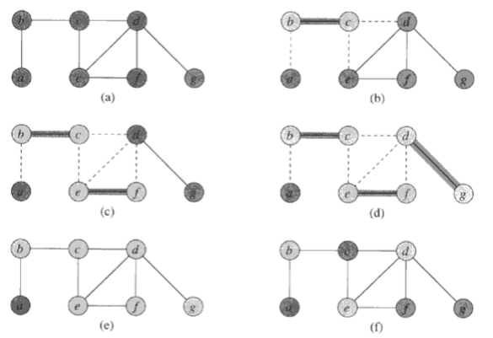

Slide 47
The solution of above graph according to the approximate algorithm is {b, c, d, e, f, g}.
This algorithm selects an arbitrary edge and removes the incident edges to it.
This process continues until to cover all the vertexes.
At first edge (b, c) is chosen from Fig. (b), then (b, a), (c, d) and (c, e) edges are discarded from the graph.
Next arbitrary edge (e, f) is chosen and edge (e, d), (f, d) is discarded.
Lastly arbitrary edge (d, g) is chosen.
After then no edge remains to be discarded.
So the vertex cover set is {b, c, d, e, f, g}.

Slide 48
Complexity Analysis of the approximate vertex cover algorithm
Since,
the loop in algorithm, on lines (3-6) repeatedly picks an edge (u, v) from E′ adds its endpoints u and v to C, and deletes all edges in E′ that are covered by either u or v.
The running time of this algorithm is O (E).

Slide 49
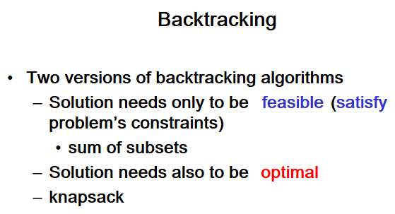

Slide 50
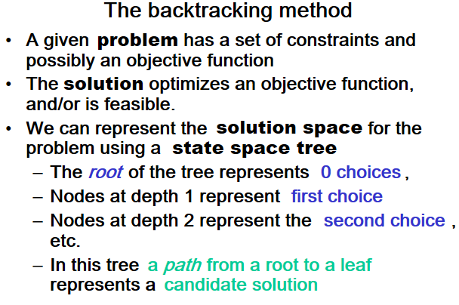

Slide 51
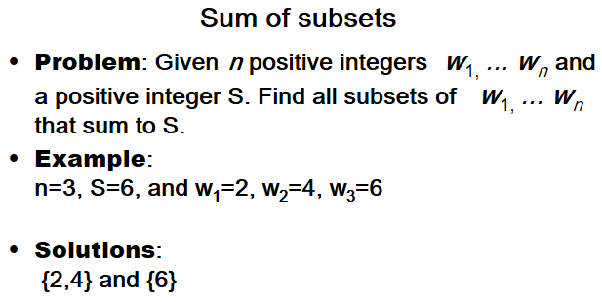

Slide 52
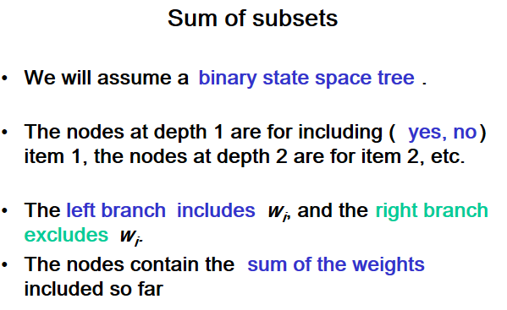

Slide 53
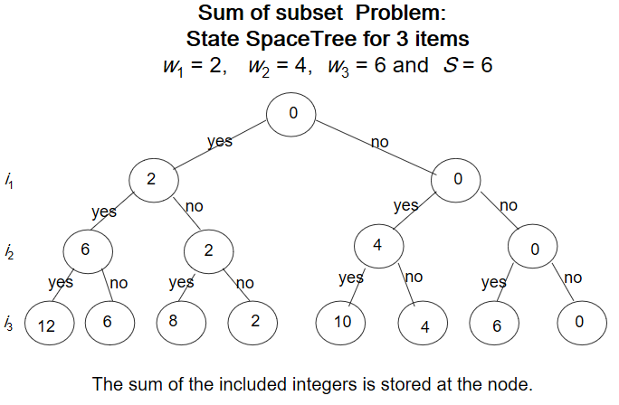

Slide 54
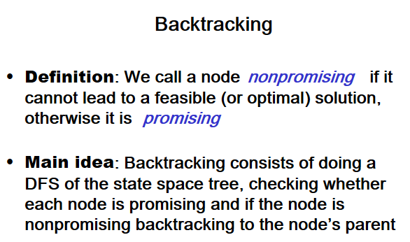

Slide 55
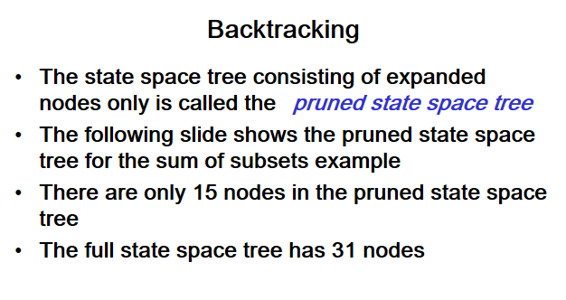

Slide 56
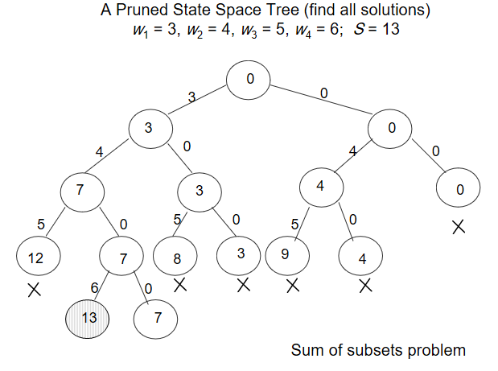

Slide 57
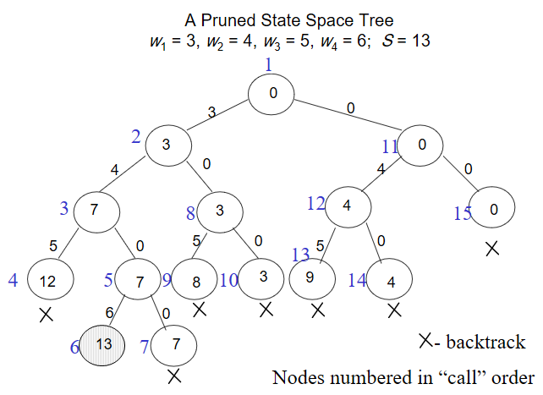

Slide 58
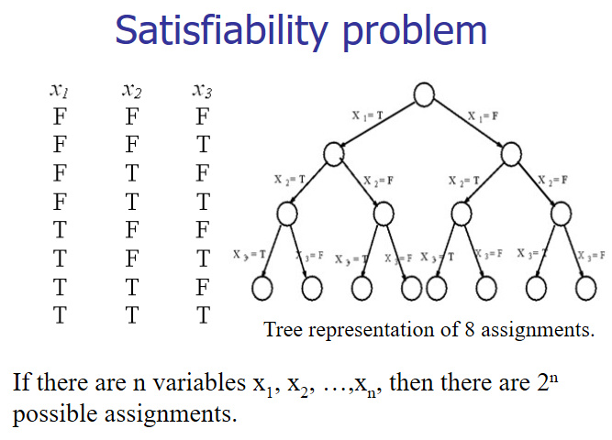

Slide 59
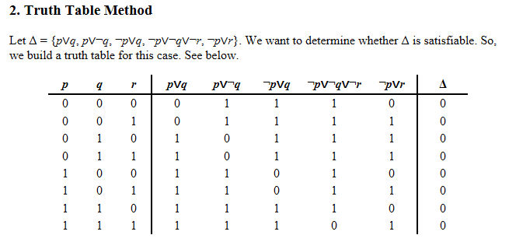

Slide 60
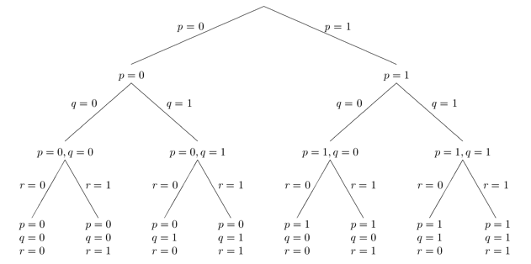

Slide 61
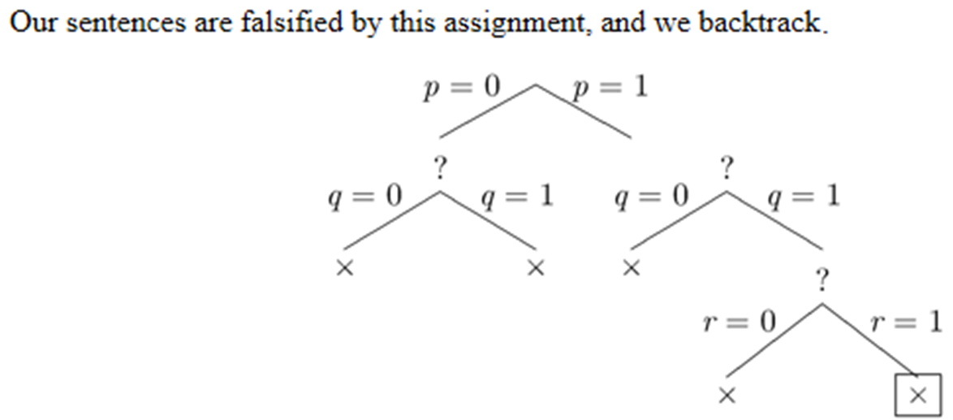
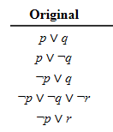

Slide 62
Thanks!!!
Queries?

